Slide 1

Calibrating 14C dates and age-depth modelling

Slide 2
All age-depth models are wrong! But are getting better (Trachsel and Telford 2017)
Age depth modelling routines have been improved greatly in the last 10 years (Trachsel and Telford 2017)
Struggle to produce reliable sediment accumulation rates
Bayesian models are slightly more difficult to use than regression-based ones

Slide 3
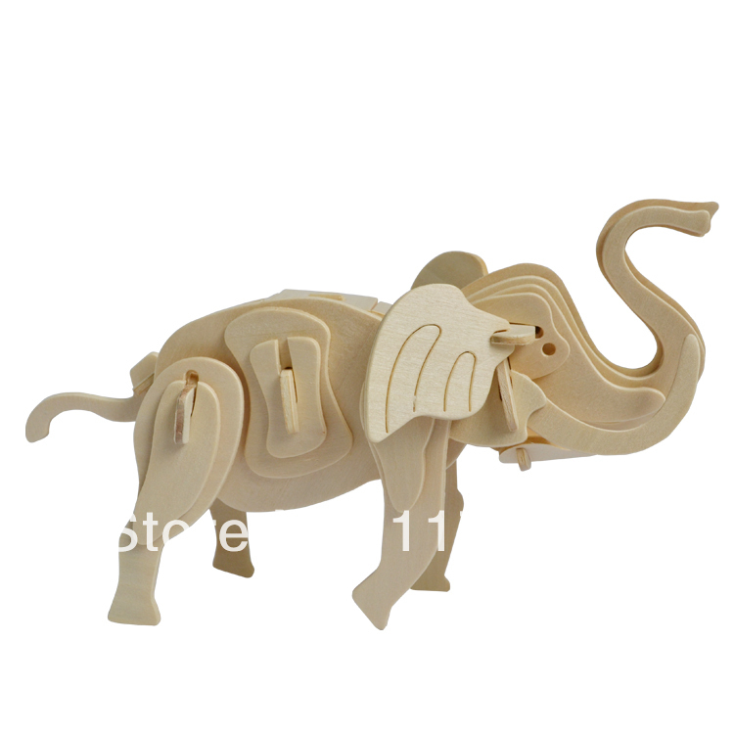
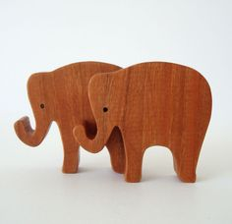
Bayesian age-modelling
Bayes: combine data with prior information
express everything in probabilities, not “black/white”
Bchron: Parnell et al., 2011
OxCal: Bronk Ramsey, 2008
Bacon: Blaauw and Christen, 2011
Prior information:
chronological ordering dates in stratigraphy
accumulation rate, ranges and variation; hiatuses
outlying dates
Notes:
Prior information. The accumulation rate prior consists of a gamma distribution, which is much like a normal/Gaussian distribution but is often asymmetric and always positive. (since we can often safely assume that deposits did not accumulate backwards in time).

Slide 4
Bayesian age-modelling
Bayes: combine data with prior information
express everything in probabilities, not “black/white”
Bchron: Parnell et al., 2011
OxCal: Bronk Ramsey, 2008
Bacon: Blaauw and Christen, 2011
Prior information:
chronological ordering dates in stratigraphy
accumulation rate, ranges and variation; hiatuses
outlying dates

Slide 5
Bchron
Bchron does not allow users to change settings
Accumulation rates in consecutive segments are unreleated, hence abrupt changes in accumulation rates are possible
For low number of dates the confidence intervals are too wide
Bchron is fast and user-friendly

Slide 6
Installing Bchron
Install.packages(“Bchron”)
Once R has responded, then type:
library(Bchron) #This will load all the Bchron functions.
BchronCalibrate
Bchronology

Slide 7
BchronCalibrate
#Calibrate a single age
Ages1 = BchronCalibrate (ages = 11500, ageSds 230, calCurves = “shcal13”, ids =“Date-1”
# Calibrate multiple ages with different calibration curves
Ages 2 = BchronCalibrate(ages = c(3445, 7632, 11500), ageSds = c(50,110, 230), calCurves = c(‘shcal13’, ‘shcal13’, ‘marine13’))
# Calibrate multiple ages with multiple calibration curves and including depth
Ages3 = BchronCalibrate(ages = c(3445, 11500), ageSds = c(50,230), positions = c(100,150), calCurves = c(‘shcal13’, ‘marine13’))
Notes:
This function provides a direct numerical strategy for computing calibrated radiocarbon ages

Slide 8
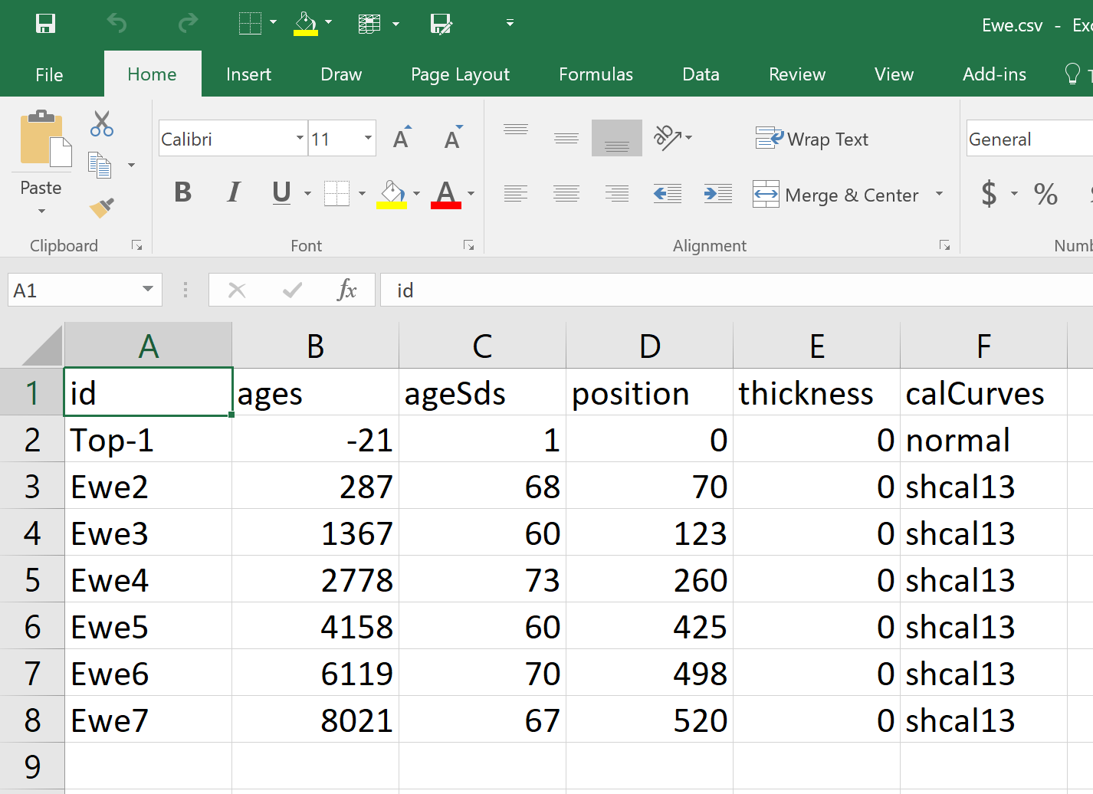
Bchron Input file set up! Important
BchronCalibrate(ages, ageSds, calCurves, ids = NULL, positions = NULL, pathToCalCurves = system.file(“data”, package = “Bchron”), eps = 1e-05, dfs = rep(100, length(ages)))
Names given for each age…
Top-1 is different as this is the surface sample

Slide 9
Bchron Input file set up! Important
BchronCalibrate(ages, ageSds, calCurves, ids = NULL, positions = NULL, pathToCalCurves = system.file(“data”, package = “Bchron”), eps = 1e-05, dfs = rep(100, length(ages)))
Uncalibrated ages

Slide 10
Bchron Input file set up! Important
BchronCalibrate(ages, ageSds, calCurves, ids = NULL, positions = NULL, pathToCalCurves = system.file(“data”, package = “Bchron”), eps = 1e-05, dfs = rep(100, length(ages)))
Error bars

Slide 11
Bchron Input file set up! Important
BchronCalibrate(ages, ageSds, calCurves, ids = NULL, positions = NULL, pathToCalCurves = system.file(“data”, package = “Bchron”), eps = 1e-05, dfs = rep(100, length(ages)))
Depth

Slide 12
Bchron Input file set up! Important
BchronCalibrate(ages, ageSds, calCurves, ids = NULL, positions = NULL, pathToCalCurves = system.file(“data”, package = “Bchron”), eps = 1e-05, dfs = rep(100, length(ages)))
Thickness value of the slice. Default is zero

Slide 13
Bchron Input file set up! Important
BchronCalibrate(ages, ageSds, calCurves, ids = NULL, positions = NULL, pathToCalCurves = system.file(“data”, package = “Bchron”), eps = 1e-05, dfs = rep(100, length(ages)))
Surface should be normal

Slide 14
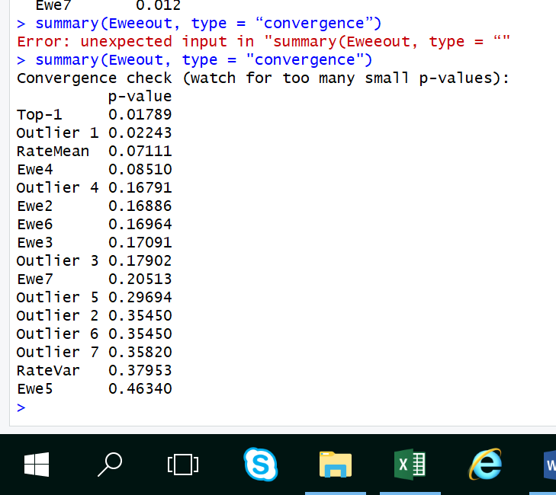
Bchronology
Filenameout = Bchronology(ages = Filename$ages, ageSds = Filename$ageSds, calCurves = Filename$calCurves,positions = Filename$position, positionThicknesses = Filename$thickness, ids = Filename$id,predictPositions = seq(0,310,by=5))
plot(Filenameout)
summary(Filenameout)
summary(Filenameout, type = “convergence”) #checks your model for convergence
summary(Filenameout, type = “outliers”) # Look at your outlier probabilities
Notes:
Why outliers?
chance? About 1 in 20 dates are off...
contamination?
errors in labelling?
real?

Slide 15
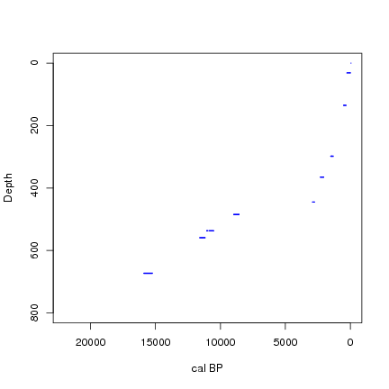
800 cm core
9 ¹⁴C dates
surface = recent
Notes:
15

Slide 16
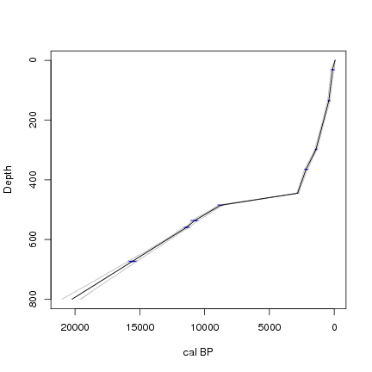
800 cm core
9 ¹⁴C dates
surface = recent
Linear interpol.
Too much weight on
individual dates?
Notes:
16

Slide 17
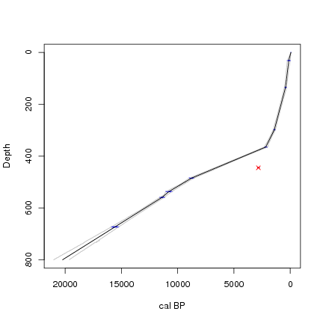
800 cm core
9 ¹⁴C dates
surface = recent
Linear interpol.
date 6 = outlier
Notes:
17

Slide 18
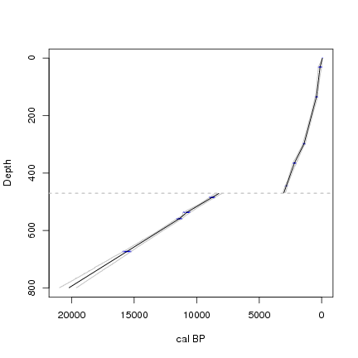
800 cm core
9 ¹⁴C dates
surface = recent
Linear interpol.
470 cm = hiatus
Notes:
18

Slide 19
Bchronology
Filenameout = Bchronology(ages = Filename$ages, ageSds = Filename$ageSds, calCurves = Filename$calCurves,positions = Filename$position, positionThicknesses = Filename$thickness, ids = Filename$id,predictPositions = seq(0,310,by=5))
plot(Filenameout)
summary(Filenameout)
summary(Filenameout, type = “convergence”) #checks your model for convergence
summary(Filenameout, type = “outliers”) # Look at your outlier probabilities
Notes:
Why outliers?
chance? About 1 in 20 dates are off...
contamination?
errors in labelling?
real?
Generally, Bacon will perform millions of MCMC iterations for each age-model run, although only a fraction of these will be stored. In most cases the remaining MCMC iterations will be well-mixed (the upper left panel of the fit of the iterations shows no strange features such as sudden systematic drops or rises). However, if the iterations seem not well mixed, or if too few remain (say less than 1,000), then it would be wise to run the core again but with a larger sample size (e.g., ssize=8000, default 2000). Alternatively, if the run has a visible remaining burn-in, this can be removed with the command scissors(). To remove, e.g., the first 300 iterations, type scissors(300). The remaining iterations can also be 'thinned', by randomly removing a proportion. For example to remove 10% of the iterations, type thinner(0.1). After running either the scissors or thinner command, plot the age-model again using the command agedepth().This will not update the pdf version of the graph in your core's folder (unless you specify plot.pdf=TRUE). Baconvergence() runs a core several times and tests if the MCMC mixing of your core, with the applied settings, can be trusted. Any value above the 1.05 threshold of the ‘Gelman and Rubin Reduction Factor’ indicates poor mixing (Brooks and Gelman, 1998). If this happens, try increasing the number of MCMC iterations using ssize as outlined above.

Slide 20
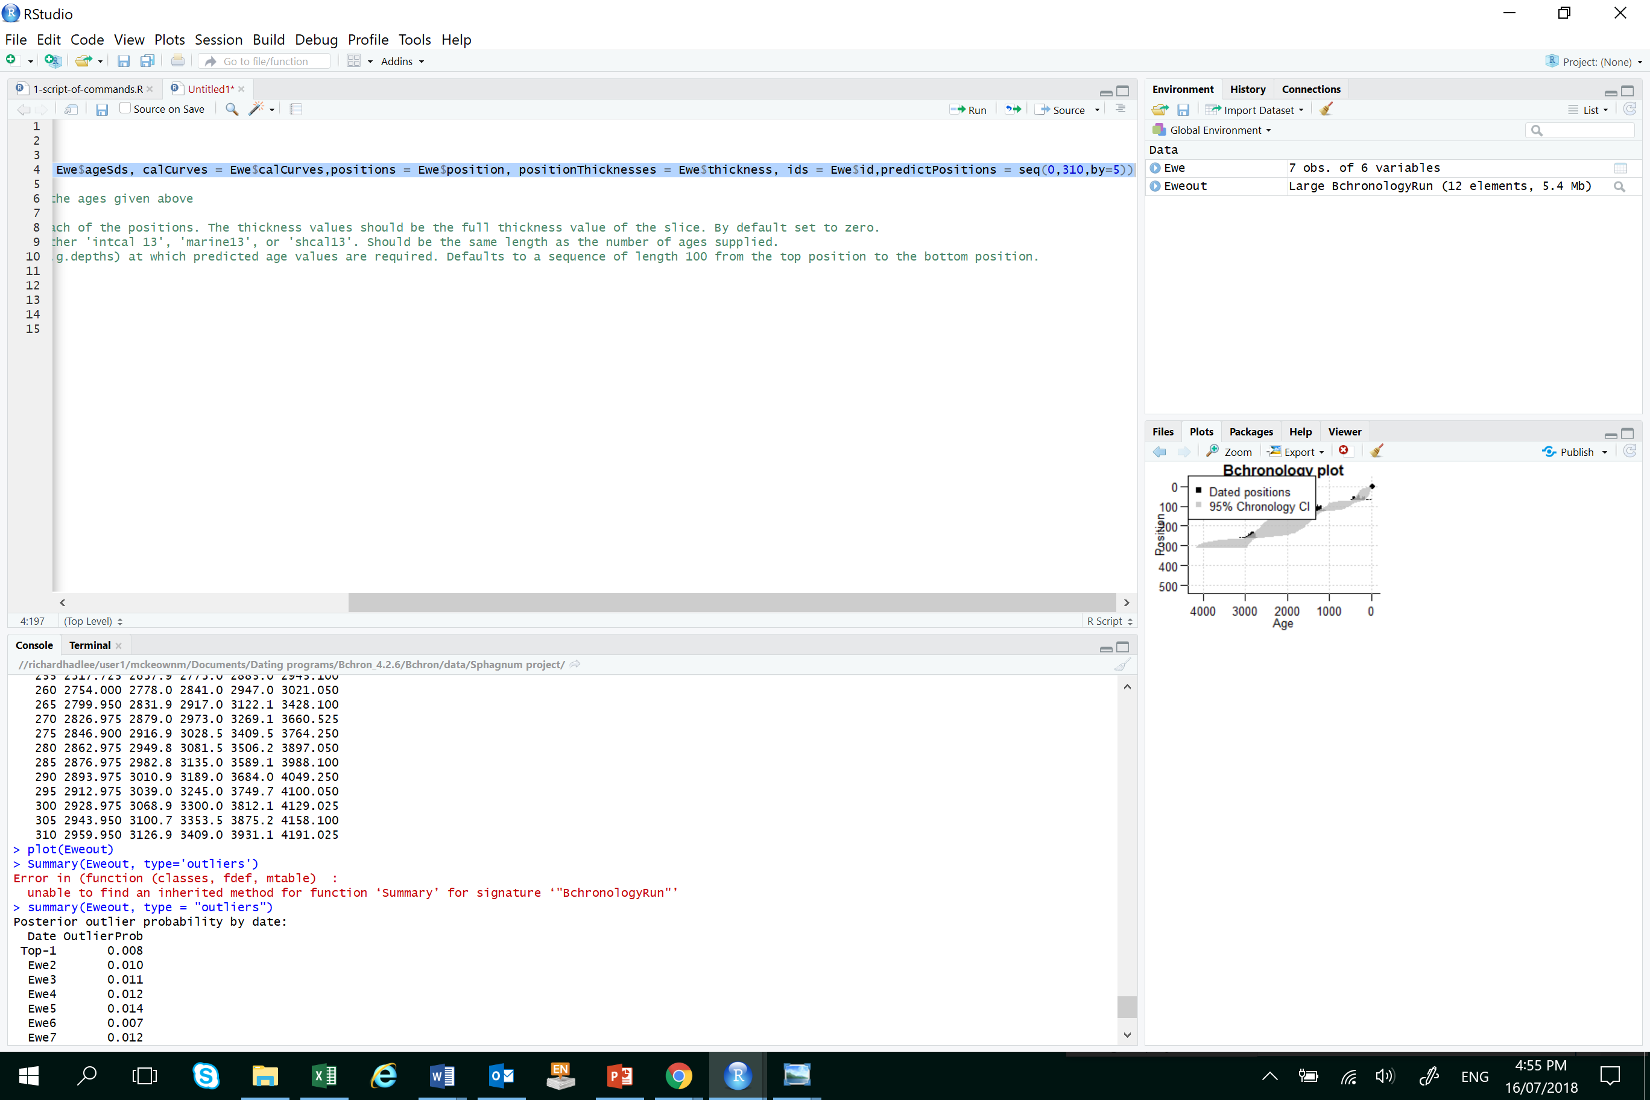

Slide 21
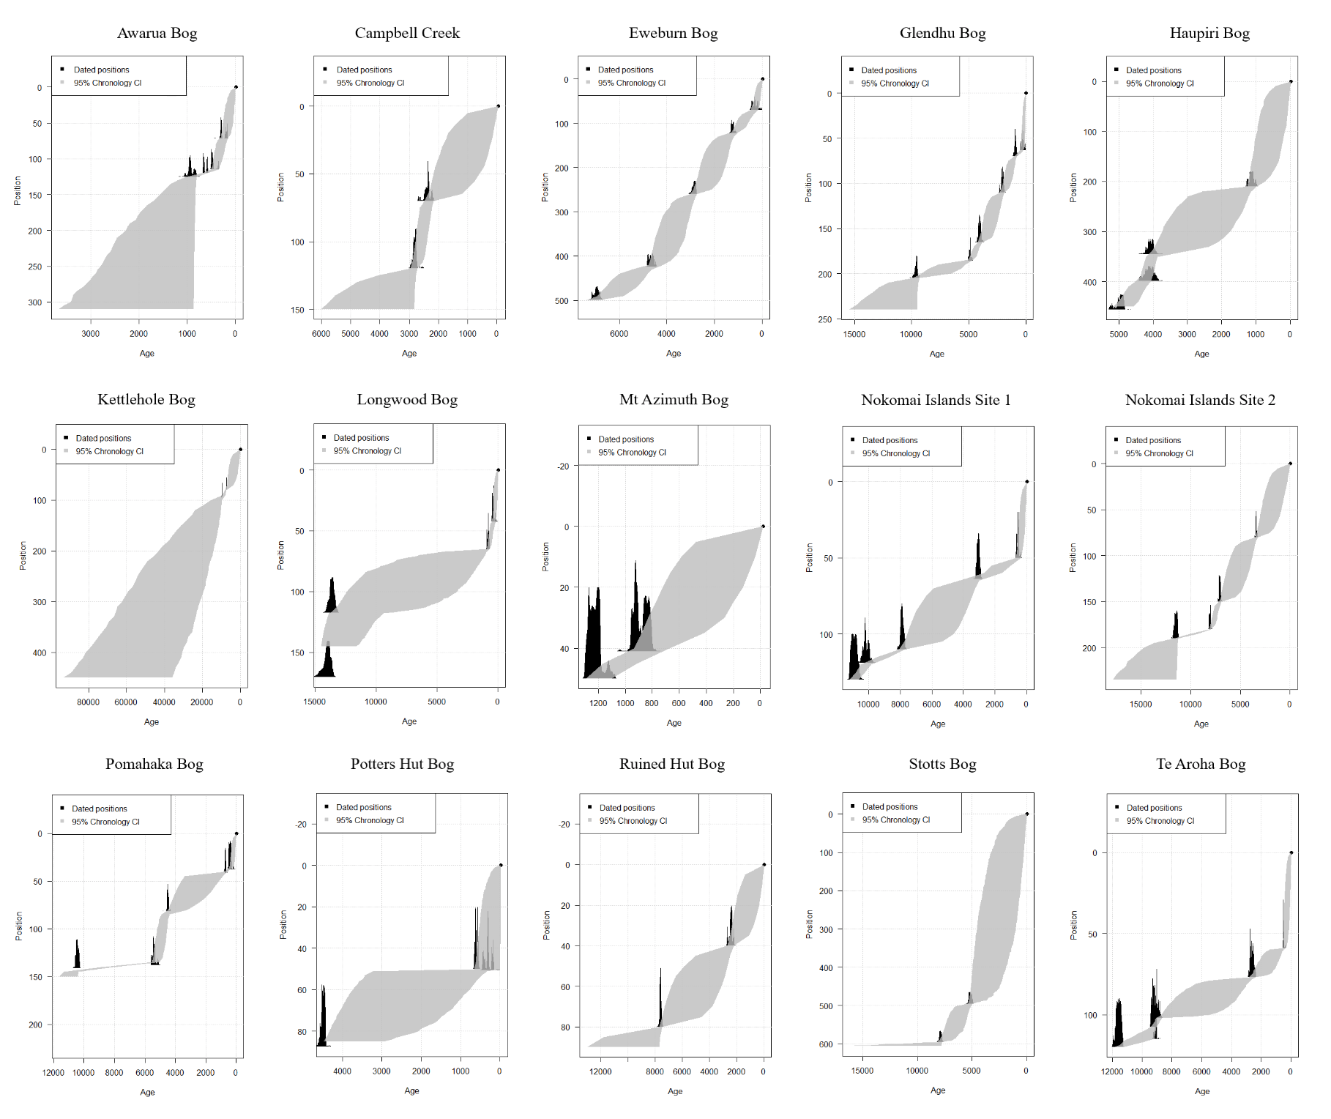

Slide 22
Bacon
Users have to define prior distributions and the segment length over which the accumulation is constant
Goring et al. (2012) – default settings in the package
Suggest changing the prior for mean accumulation rate according to the information available from the 14C dates
Top tip – when changing segment lengths choose segment lengths shorter than the mean distance between the dated levels
Time consuming
Notes:
Changing the shape of the accumulation rate prior influences age-depth models.

Slide 23
